Slide 1
Network Programming

Slide 2
Networking Basics
TCP ?
UDP ?
Port Number ?
IP Address ?

Slide 3
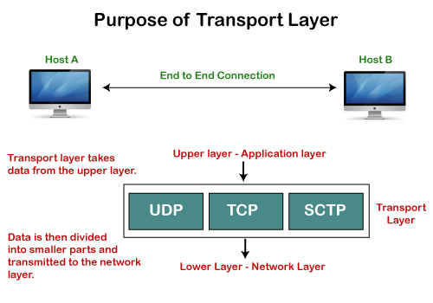
Transmission Control Protocol
TCP stands for Transmission Control Protocol. It is a transport layer protocol that facilitates the transmission of packets from source to destination. It is a connection-oriented protocol that means it establishes the connection prior to the communication that occurs between the computing devices in a network. This protocol is used with an IP protocol, so together, they are referred to as a TCP/IP.
The main functionality of the TCP is to take the data from the application layer. Then it divides the data into a several packets, provides numbering to these packets, and finally transmits these packets to the destination. The TCP, on the other side, will reassemble the packets and transmits them to the application layer. As we know that TCP is a connection-oriented protocol, so the connection will remain established until the communication is not completed between the sender and the receiver.
Features of TCP protocol
Transport Layer Protocol
Reliable
Order of the data is maintained
Connection-oriented
Full duplex
Stream-oriented

Slide 4
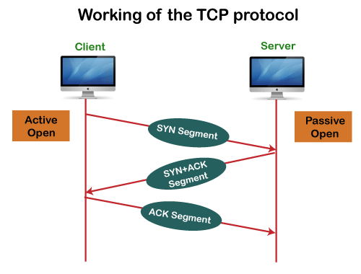
Advantages of TCP
It provides a connection-oriented reliable service, which means that it guarantees the delivery of data packets. If the data packet is lost across the network, then the TCP will resend the lost packets.
It provides a flow control mechanism using a sliding window protocol.
It provides error detection by using checksum and error control by using Go Back or ARP protocol.
It eliminates the congestion by using a network congestion avoidance algorithm that includes various schemes such as additive increase/multiplicative decrease (AIMD), slow start, and congestion window.
Disadvantage of TCP
It increases a large amount of overhead as each segment gets its own TCP header, so fragmentation by the router increases the overhead.

Slide 5
TCP VS UDP
KEY DIFFERENCES:
TCP is a connection-oriented protocol, whereas UDP is a connectionless protocol.
The speed for TCP is slower while the speed of UDP is faster
TCP uses handshake protocol like SYN, SYN-ACK, ACK while UDP uses no handshake protocols
TCP does error checking and also makes error recovery, on the other hand, UDP performs error checking, but it discards erroneous packets.
TCP has acknowledgment segments, but UDP does not have any acknowledgment segment.
TCP is heavy-weight, and UDP is lightweight.
When to use UDP and TCP?
TCP is an ideal choice, and even it has associated overhead, Therefore, when most of the overhead is in the connection, your application stays connected for any length of time.
UDP is ideal to use with multimedia like VoIP.
Use TCP sockets when both client and server independently send packets at that time; an occasional delay is acceptable. (e.g., Online Poker).
You should use user UDP if both client and server may separately send packets, and occasional delay is also not acceptable. (e.g., Multiplayer games).

Slide 6
What is a TCP port?
The TCP port is a unique number assigned to different applications. For example, we have opened the email and games applications on our computer; through email application, we want to send the mail to the host, and through games application, we want to play the online games. In order to do all these tasks, different unique numbers are assigned to these applications. Each protocol and address have a port known as a port number. The TCP (Transmission Control Protocol) and UDP (User Datagram Protocol) protocols mainly use the port numbers.
A port number is a unique identifier used with an IP address. A port is a 16-bit unsigned integer, and the total number of ports available in the TCP/IP model is 65,535 ports. Therefore, the range of port numbers is 0 to 65535. In the case of TCP, the zero-port number is reserved and cannot be used, whereas, in UDP, the zero port is not available. IANA (Internet Assigned Numbers Authority) is a standard body that assigns the port numbers.
Example of port number:
192.168.1.100: 7
In the above case, 192.168.1.100 is an IP address, and 7 is a port number.
To access a particular service, the port number is used with an IP address. The range from 0 to 1023 port numbers are reserved for the standard protocols, and the other port numbers are user-defined.
Why do we require port numbers?
A single client can have multiple connections with the same server or multiple servers. The client may be running multiple applications at the same time. When the client tries to access some service, then the IP address is not sufficient to access the service. To access the service from a server, the port number is required. So, the transport layer plays a major role in providing multiple communication between these applications by assigning a port number to the applications.

Slide 7
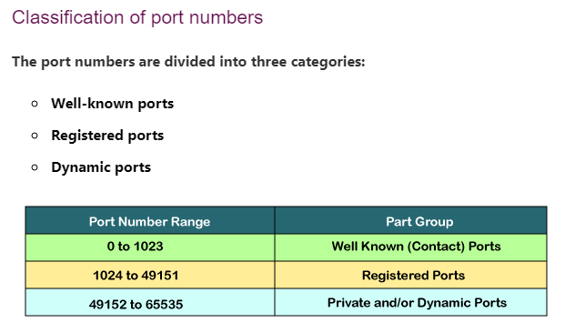
Port Number | Usage
20 | File Transfer Protocol (FTP) Data Transfer
21 | File Transfer Protocol (FTP) Command Control
22 | Secure Shell (SSH)
23 | Telnet - Remote login service, unencrypted text messages
25 | Simple Mail Transfer Protocol (SMTP) E-mail Routing
53 | Domain Name System (DNS) service
80 | Hypertext Transfer Protocol (HTTP) used in World Wide Web
110 | Post Office Protocol (POP3) used by e-mail clients to retrieve e-mail from a server
119 | Network News Transfer Protocol (NNTP)
123 | Network Time Protocol (NTP)
143 | Internet Message Access Protocol (IMAP) Management of Digital Mail
161 | Simple Network Management Protocol (SNMP)
194 | Internet Relay Chat (IRC)
443 | HTTP Secure (HTTPS) HTTP over TLS/SSL

Slide 8
What is Socket?
A Socket is an endpoint of a two way communication link between two programs running on the network.
The Socket is bound to a port number so that TCP Layer can identify the application that data is destined to be sent.
Client Port
Server Port
Connection

Slide 9
Socket Programming in Java
Java Socket Programming is used for communication between the application that is running on different JRE.
It can be either connection oriented or connection less.
Socket and ServerSocket classes are used for connection-oriented socket programming.
DatagramSocket and DatagramPacket classes are used for connection-less socket programming.
The client in socket programming must know two information:
IP address of Server
Port Number.

Slide 10
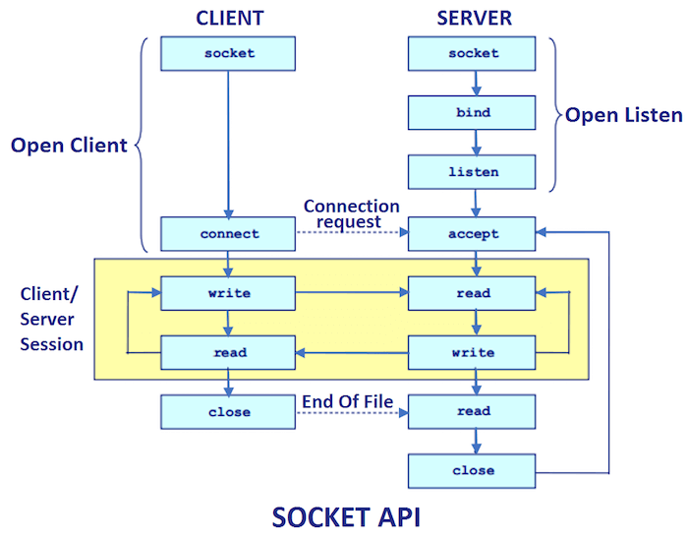

Slide 11
TCP Socket (Client and Server Side)
Creating Server:
ServerSocket ss=new ServerSocket(6666);
Socket s=ss.accept();//establishes connection and waits for the client
Creating Client:
Socket s=new Socket("localhost",6666);

Slide 12
Socket/ServerSocket Classes
Method | Description
1) public InputStream getInputStream() | returns the InputStream attached with this socket.
2) public OutputStream getOutputStream() | returns the OutputStream attached with this socket.
3) public synchronized void close() | closes this socket
Socket class
A socket is simply an endpoint for communications between the machines. The Socket class can be used to create a socket.
ServerSocket class
The ServerSocket class can be used to create a server socket. This object is used to establish communication with the clients.
Method | Description
1) public Socket accept() | returns the socket and establish a connection between server and client.
2) public synchronized void close() | closes the server socket.

Slide 13
MyServer.java
import java.io.*;
import java.net.*;
public class MyServer {
public static void main(String[] args){
try{
ServerSocket ss=new ServerSocket(6666);
Socket s=ss.accept();//establishes connection
DataInputStream dis=new DataInputStream(s.getInputStream());
String str=(String)dis.readUTF();
System.out.println("message= "+str);
ss.close();
}catch(Exception e){System.out.println(e);}
}
}

Slide 14
MyClient.java
import java.io.*;
import java.net.*;
public class MyClient {
public static void main(String[] args) {
try{
Socket s=new Socket("localhost",6666);
DataOutputStream dout=new DataOutputStream(s.getOutputStream());
dout.writeUTF("Hello Server");
dout.flush();
dout.close();
s.close();
}catch(Exception e){System.out.println(e);}
}
}

Slide 15
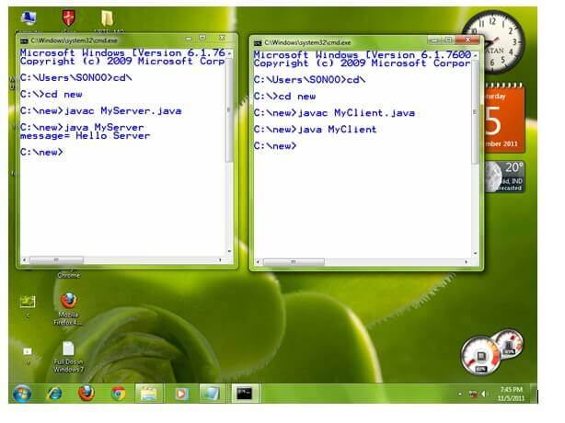
Output

Slide 16
Classworks
Write a program using Connection oriented Socket Programming that can read write on both side.
OR,
Develop a chat software that communicates both sides.
One Solution, check [https://www.youtube.com/watch?v=kqBmsLvWU14]

Slide 17
UDP Socket (Client and Server Side)
//DSender.java
import java.net.*;
public class DSender{
public static void main(String[] args) throws Exception {
DatagramSocket ds = new DatagramSocket();
String str = "Welcome java";
InetAddress ip = InetAddress.getByName("127.0.0.1");
DatagramPacket dp = new DatagramPacket(str.getBytes(), str.length(), ip, 3000);
ds.send(dp);
ds.close();
}
}
//DReceiver.java
import java.net.*;
public class DReceiver{
public static void main(String[] args) throws Exception {
DatagramSocket ds = new DatagramSocket(3000);
byte[] buf = new byte[1024];
DatagramPacket dp = new DatagramPacket(buf, 1024);
ds.receive(dp);
String str = new String(dp.getData(), 0, dp.getLength());
System.out.println(str);
ds.close();
}
}

Slide 18
Old Questions
What is a socket? Write client and server programs in which a server program accepts a radius of a circle from the client program computes area, sends the computed area to the client program, and displays it by client program.[1+4] [2075]
https://www.youtube.com/watch?v=zHmgPfcBp_A

Slide 19

Working with URLs (Uniform Resource Locator)
A URL contains many information:
Protocol: In this case, http is the protocol.
Server name or IP Address: In this case, www.javatpoint.com is the server name.
Port Number: It is an optional attribute. If we write http//ww.javatpoint.com:80/socket/ , 80 is the port number. If port number is not mentioned in the URL, it returns -1.
File Name or directory name: In this case, index.jsp is the file name.

Slide 20
//URLDemo.java
import java.net.*;
public class URLDemo{
public static void main(String[] args){
try{
URL url=new URL("http://www.javatpoint.com/java-tutorial");
System.out.println("Protocol: "+url.getProtocol());
System.out.println("Host Name: "+url.getHost());
System.out.println("Port Number: "+url.getPort());
System.out.println("File Name: "+url.getFile());
}catch(Exception e){System.out.println(e);}
}
}
Protocol: http
Host Name: www.javatpoint.com
Port Number: -1
File Name: /java-tutorial

Slide 21
InetAddress class
Java InetAddress class represents an IP address. The java.net.InetAddress class provides methods to get the IP of any host name for example www.javatpoint.com, www.google.com, www.facebook.com, etc.
import java.io.*;
import java.net.*;
public class InetDemo{
public static void main(String[] args){
try{
InetAddress ip=InetAddress.getByName("www.javatpoint.com");
System.out.println("Host Name: "+ip.getHostName());
System.out.println("IP Address: "+ip.getHostAddress());
}catch(Exception e){System.out.println(e);}
}
}
Host Name: www.javatpoint.com
IP Address: 206.51.231.148

Slide 22
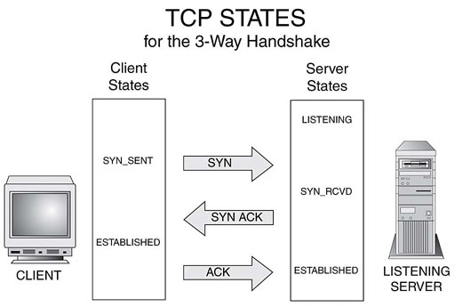
Half Close Socket (TCP Half Close)
Officially, according to the RFC's, a half-open TCP connection is when one side of the established connection has crashed, and did not send notification that the connection was ending. This is not the common usage today.

Slide 23
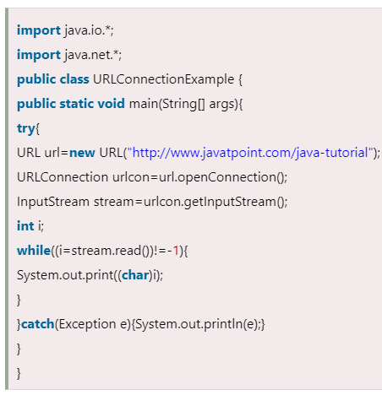
Java URLConnection class
The Java URLConnection class represents a communication link between the URL and the application. This class can be used to read and write data to the specified resource referred by the URL.
The URLConnection class provides many methods, we can display all the data of a webpage by using the getInputStream() method. The getInputStream() method returns all the data of the specified URL in the stream that can be read and displayed.

Slide 24
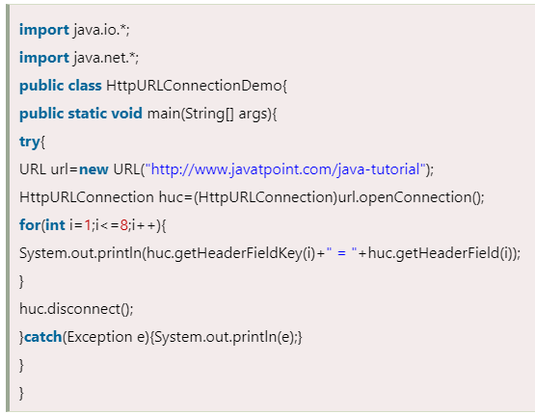
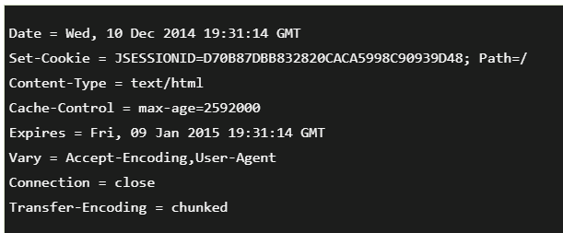
Java HttpURLConnection class
The Java HttpURLConnection class is http specific URLConnection. It works for HTTP protocol only.
By the help of HttpURLConnection class, you can information of any HTTP URL such as header information, status code, response code etc.
The java.net.HttpURLConnection is subclass of URLConnection class.

Slide 25
Sending Email
There are following three steps to send email using JavaMail. They are as follows:
Get the session object that stores all the information of host like host name, username, password etc.
The javax.mail.Session class provides two methods to get the object of session, Session.getDefaultInstance() method and Session.getInstance() method.
Properties properties=new Properties();
Session session=Session.getDefaultInstance(properties,null);
compose the message
The javax.mail.Message class provides methods to compose the message. But it is an abstract class so its subclass javax.mail.internet.MimeMessage class is mostly used.
MimeMessage message=new MimeMessage(session);
send the message
The javax.mail.Transport class provides method to send the message.
Transport.send(message);

Slide 26
Simple example of sending email in Java through Gmail Server
For sending the email using JavaMail API, you need to load the two jar files:
mail.jar
activation.jar
Load the jar file | c:\> set classpath=mail.jar;activation.jar;.;
compile the source file | c:\> javac SendEmail.java
run by | c:\> java SendEmail

